Slide 1
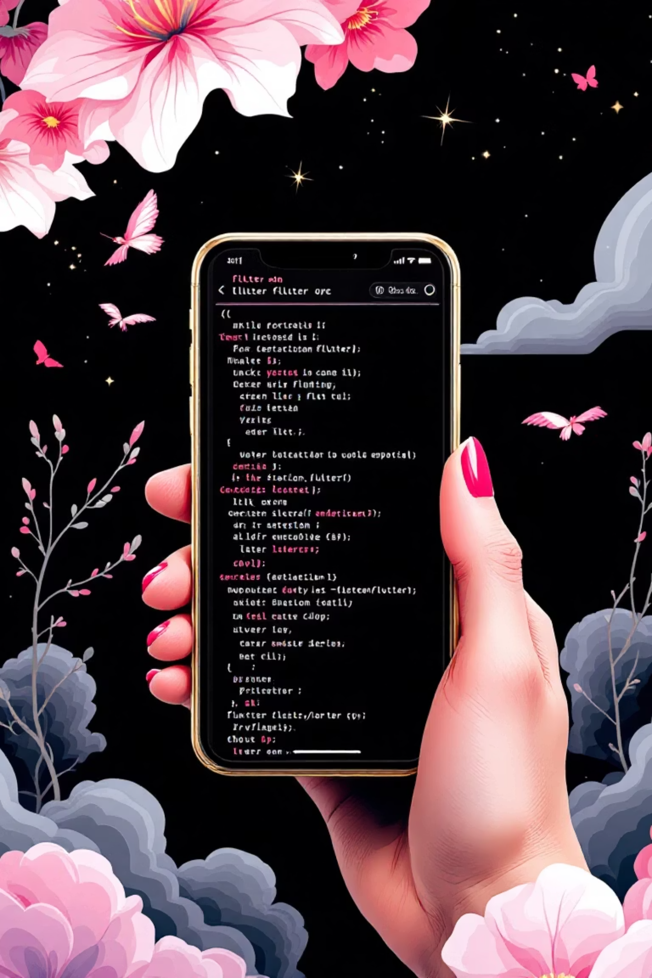
Week 6: Buttons & User Input Widgets
Making Apps Interactive
Flutter Mobile Application Development

Slide 2

CHAPTER 1
Learning Objectives
1
Explore Flutter Material Buttons
Understand the system and different types.
2
Implement Key Button Types
ElevatedButton, TextButton, OutlinedButton, FloatingActionButton.
3
Accept User Input
Using TextField with specific properties.

Slide 3

RECAP
Recap: Layouts in Flutter
Row & Column
For linear arrangements of widgets.
Stack
Overlapping elements, layering content.
Card
Grouping content with visual elevation.
Today, we add interactive elements inside these layouts, making apps respond to users.

Slide 4

The Flutter Button Family
Buttons detect gestures (clicks/taps) and trigger actions.
onPressed
child
Function called when the button is tapped.
Content inside the button (e.g., Text or Icon).
(null disables the button)

Slide 5
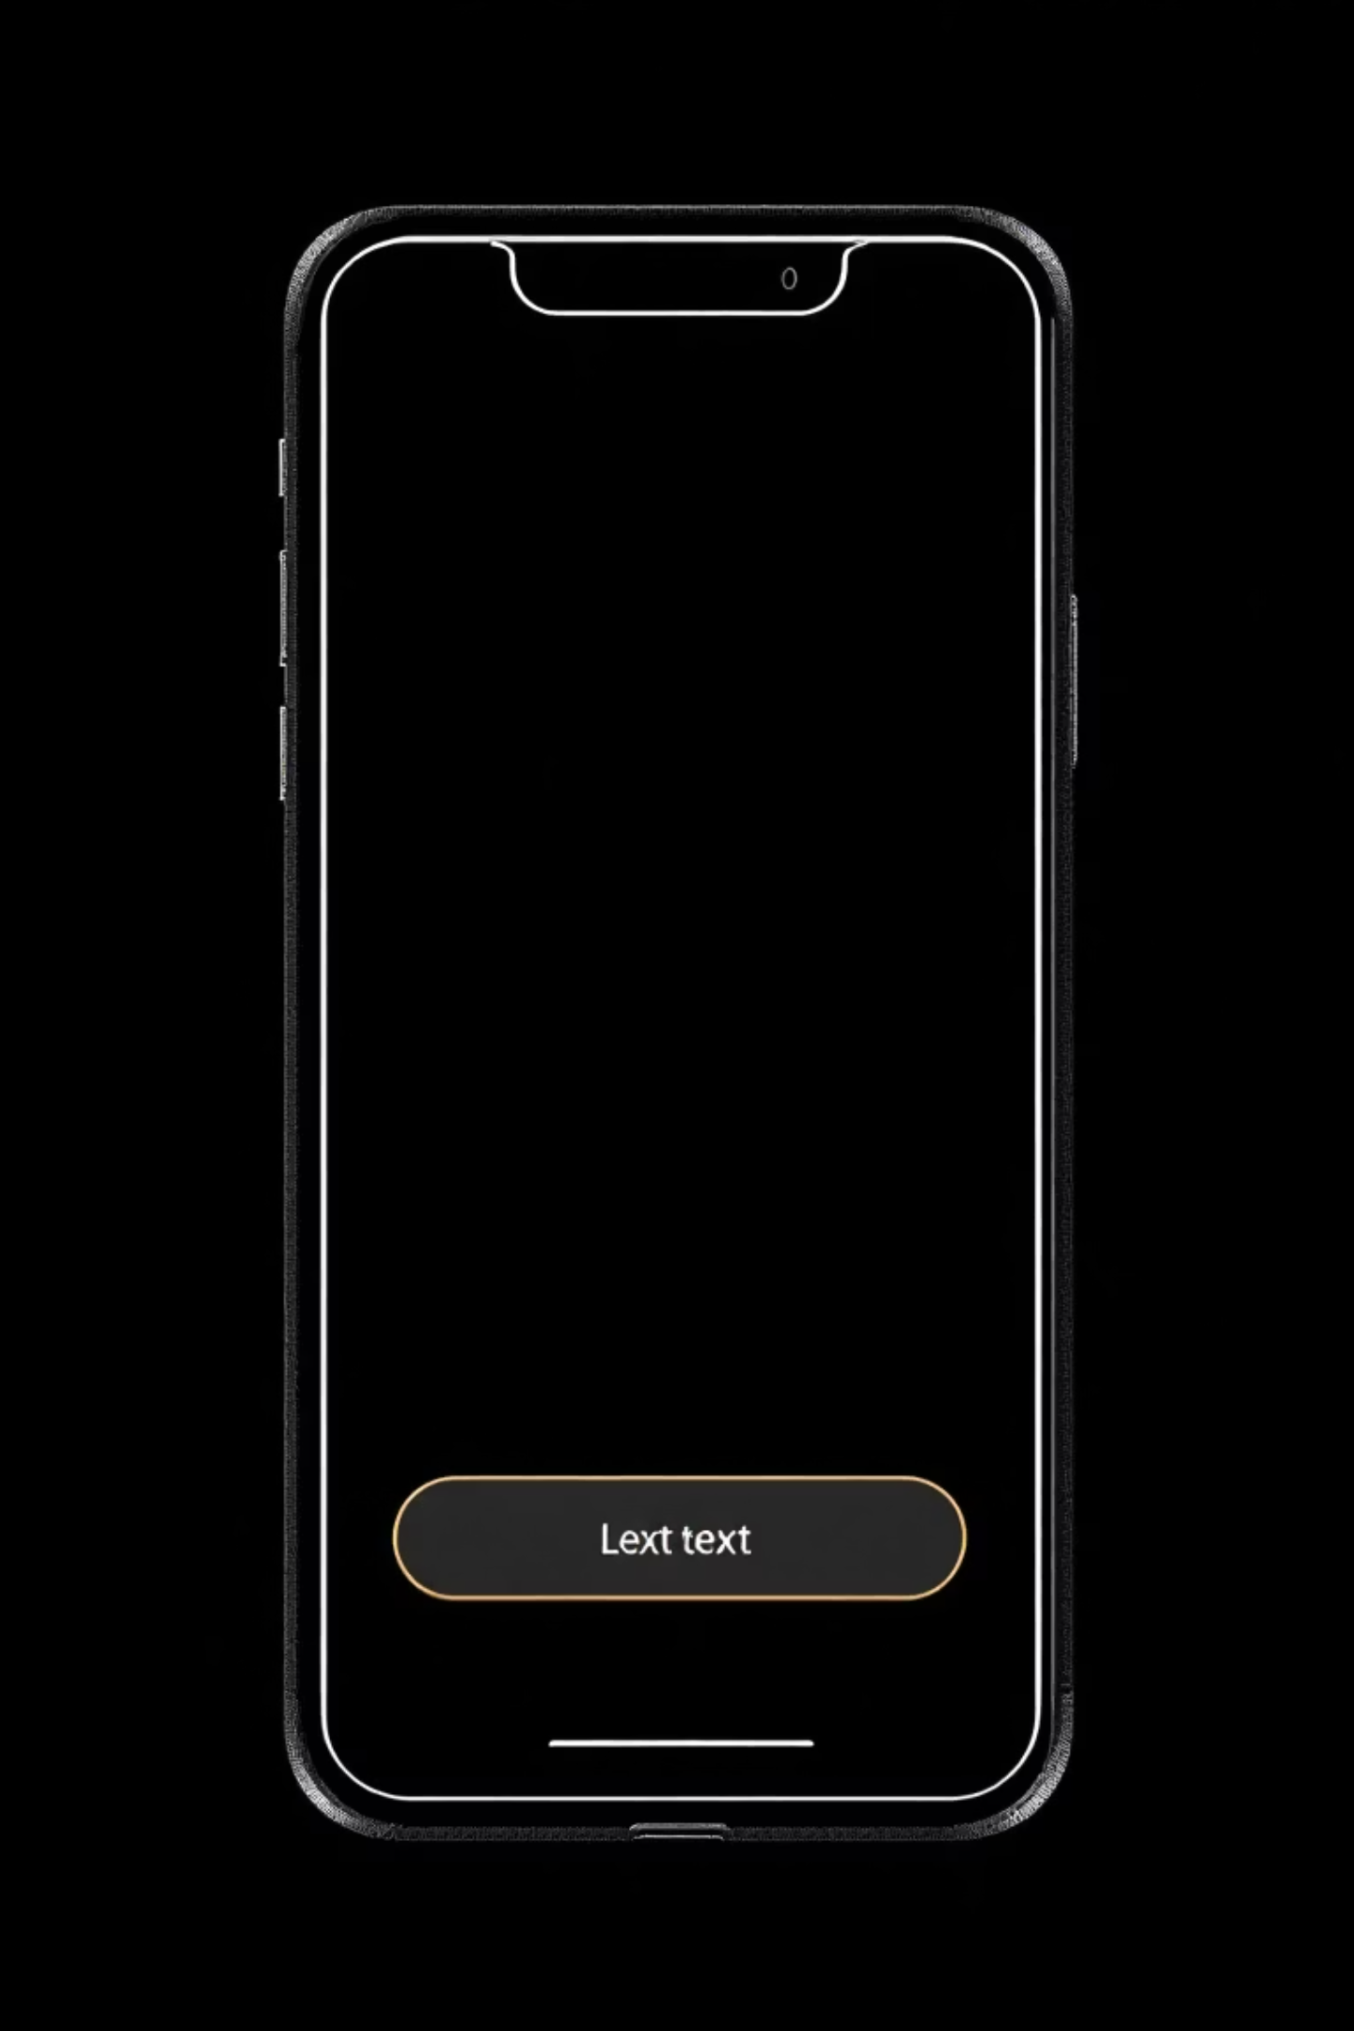
Types of Material Buttons
1
ElevatedButton
Background color & shadow, for primary actions.
2
OutlinedButton
Transparent background with a border, medium emphasis.
3
TextButton
No border or background, low emphasis (e.g., in dialogs).
4
IconButton
A simple, clickable icon.

Slide 6


Implementing Buttons
Examples of common Flutter button declarations.
ElevatedButton
OutlinedButton
ElevatedButton(
onPressed: () {
print("Clicked!");
},
child: Text("Submit"),
)
OutlinedButton(
onPressed: () {},
child: Text("Cancel"),
)

Slide 7


Floating Action Button (FAB)
Add
Compose
Navigate
A circular button that floats above content.
Promotes a primary action.
Defined in Scaffold's floatingActionButton property.

Slide 8
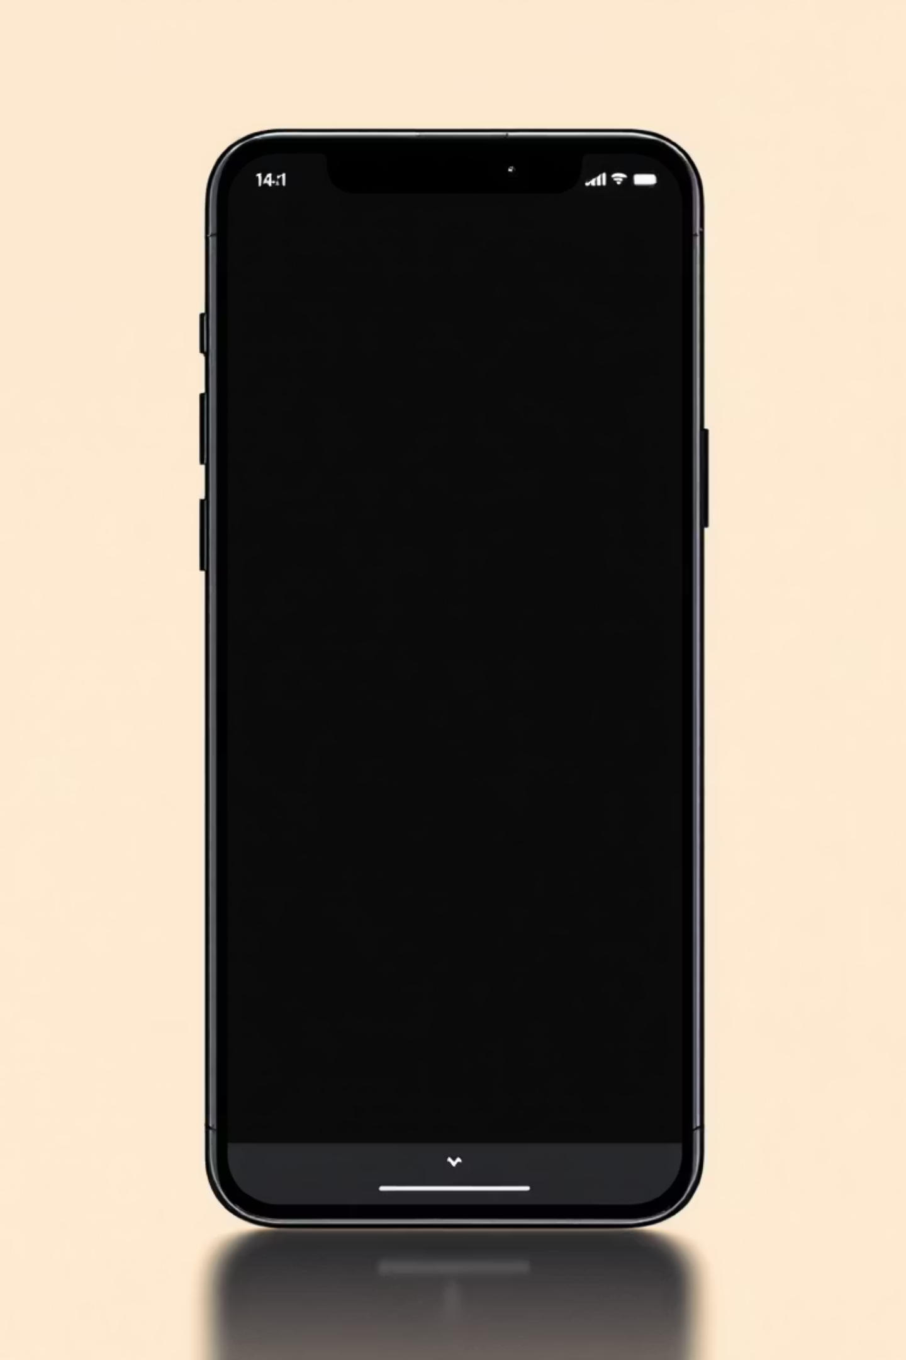
The TextField Widget
The primary way to get text input from users.
decoration
obscureText
Styles for hint text, borders, and icons.
Hides text (e.g., for passwords).
keyboardType
Sets the keyboard style (email, number, text).

Slide 9
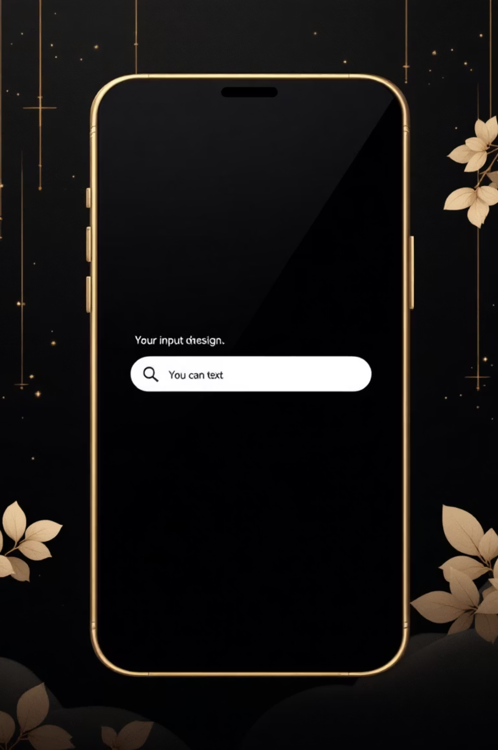
Styling Input with InputDecoration
The decoration property takes an InputDecoration object.
labelText
Floating label above input.
hintText
Placeholder when input is empty.
prefixIcon
Icon at the start of the input field.
border
OutlineInputBorder() for boxed inputs.

Slide 10

CHAPTER 2
Handling Input Data: TextEditingController
Attach a TextEditingController to a TextField to retrieve its value.
01
02
Define the Controller
Assign to TextField
final myController = TextEditingController();
controller: myController
03
Read the Text
print(myController.text);

